Slide 1


IntelleTect
Supervisor
Ms. Noor ul Ain
Automatic House Design from linguistic Descriptions
i191652
i191660
i191787
Momin Shahzad
Ali Raza
Muhammad Umer

Slide 2



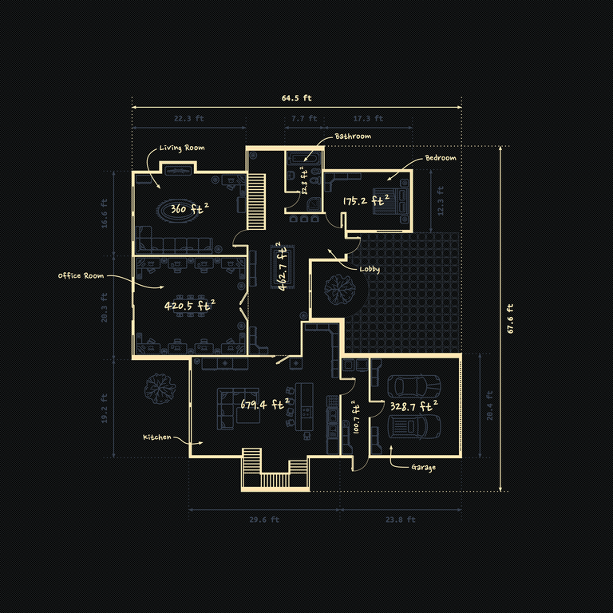
IntelleTect
Project Intro
Audio Input
Voice to text
Floor Plan Generation
Takes in Voice input
Converts into textual description.
Maps it according to labels.
Generates House plans based on descriptions
Displays plans on front-end

Slide 3



Motivation
IntelleTect
01
02
03
Easy to Use
Saves Money
Custom House Plans
No need for prior experience in the felid, "Anyone can use it"
No need to hire professional architects and waste thousands of cash
Just say what you want and it'll design it just for you.

Slide 4


Problem Statement
1
Complexity
2
Experience/Skill Needed
3
Expensive

Slide 5
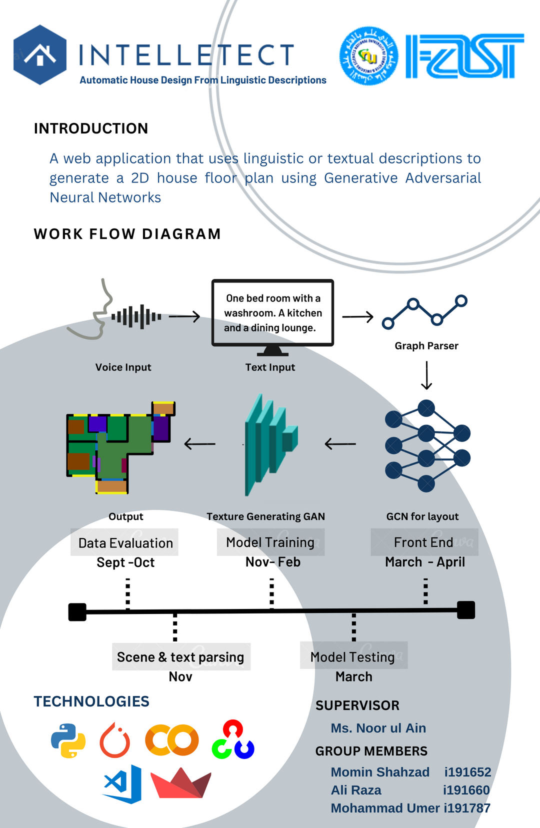
Project Poster
Practical features of the project are explained in the following poster.
1
High Level Architechture
2
Project timeline

Slide 6





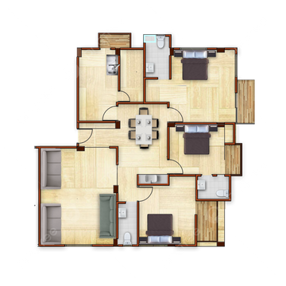
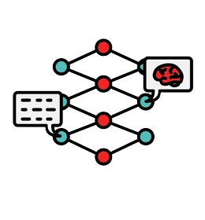
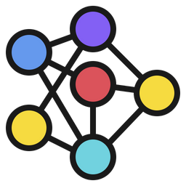
House Description
Voice Input
Text Input
Text Analysis
Graph Embeddings
Architechture
2D Floor Plan
Texture Generating GAN
GCN for layout
1
Input mapping
2
Layout Generation

Slide 7

Project Timeline
Hyperparameter tuning
Feb-april
FRONT END
april - may
DATA EVALUATION SEPT -OCT
GCN TRAINING
Nov- Feb
Testing Components
Merging components, deployment, Testing and improvements.
INPUT PARSING
OCT-NOV
Training the model
Collecting Data and configuring it to fit the model (masking)
Parsing the input text into labels for the model

Slide 8
Work Done Till Now
IntelleTect
01
02
03
04
05
Iteration 1
Iteration 2
Iteration 3
Iteration 4
Iteration 5
Collecting Data and configuring it to fit the model (masking)
Parsing the input text into labels for the model
Training the GCN
Training a Texture Generating GAN
Front End

Slide 9

Work Till FYP-II Mid
Floor layouts from the
GCN and Texture Generating GANs on the Front End

Slide 10
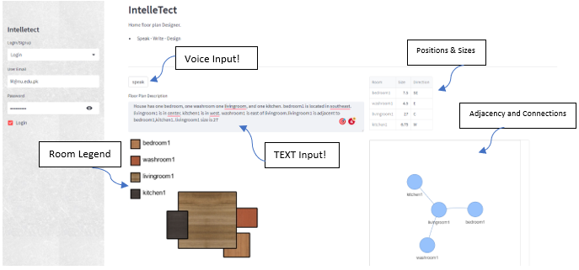
DEMO

Slide 11
IntelleTect
References
Chen, Q., Wu, Q., Tang, R., Wang, Y., Wang, S., & Tan, M. (2020). Intelligent Home 3D: Automatic 3D-House Design from Linguistic Descriptions Only. 14.
(Simon Fraser University)(Autodesk Research) [CVPR 2020]
Nauata, N., Chang, K.-H., Cheng, C.-Y., Mori, G., & Furukawa, Y. (2020, march 16). Networks for Graph-constrained House Layout. 17.
( South China University of Technology) (Guangzhou Laboratory) (Australian Centre for . Robotic Vision) (University of Adelaide, Australia) (Springr ECCV 2020)
Nauata, N., Hosseini, S., Chang, K.-H., Chu, H., Cheng, C.-Y., & Furukawa, Y. (2020). House-GAN++: Generative Adversarial Layout Refinement Network towards Intelligent Computational Agent for Professional Architects. 10.
(Simon Fraser University)(Autodesk Research)

Slide 12
LIVE DEMO

